Slide 1
S-100 Validation Tests sub group
3rd VTC Meeting
4th September 2023

Slide 2
Meeting protocol
Meeting participants are kindly requested to note the following meeting protocols;
Please keep your camera and microphone turned “off” if you are not talking or presenting
If you want to make an intervention, please turn your camera and microphone on and, raise your hand to indicate that you wish to speak
Don’t forget to turn your microphone “on” before speaking, and “off” when finished
Please use the “Chat” function to communicate an text information to the meeting
If you have any problems connecting using Firefox or other browser – please try using Chrome.

Slide 3
AGENDA
Issues raised
TWCWG Feedback on IIC Validation Tests
Initial tests Part1, Part 2, Part 4b, Part 5, Part 6, Part 7(not finished), Part 17
(S100ValidationTests_x)
Status on tasks
Next meetings

Slide 4
ISSUES
Open Issues
Issue 8 (S-100_050, S-100_061, S100_64)
Issue 9 (Part 17 checks)
Issue 10 (Checks for organization and individual information in CATALOG.XML)
Issue 11 (Proposed checks for locale consistency between resource and discovery metadata block)
Issue 12 (Require valueOfSounding or defaultClearanceDepth)
Issue 7 (use of “unknown” for feature attribute binding)
Issue 13 (Input on proposed checks relating to HDF5-format products)
Issue 6 (naming convention)
https://github.com/iho-ohi/S-100-Validation-Checks/issues

Slide 5
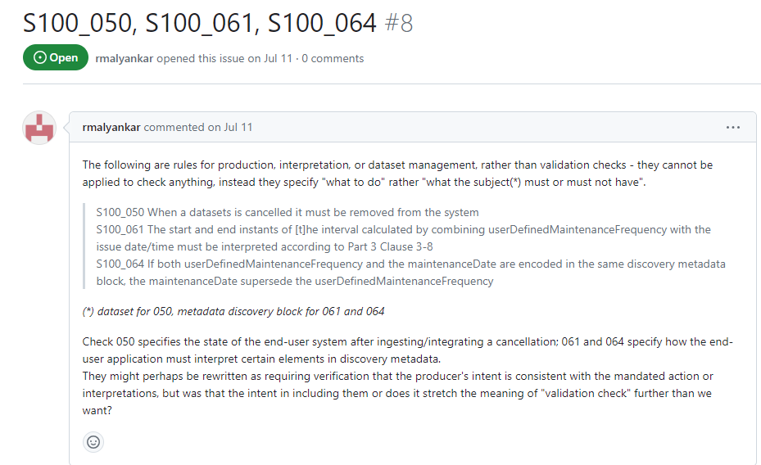
ISSUE 8

Slide 6
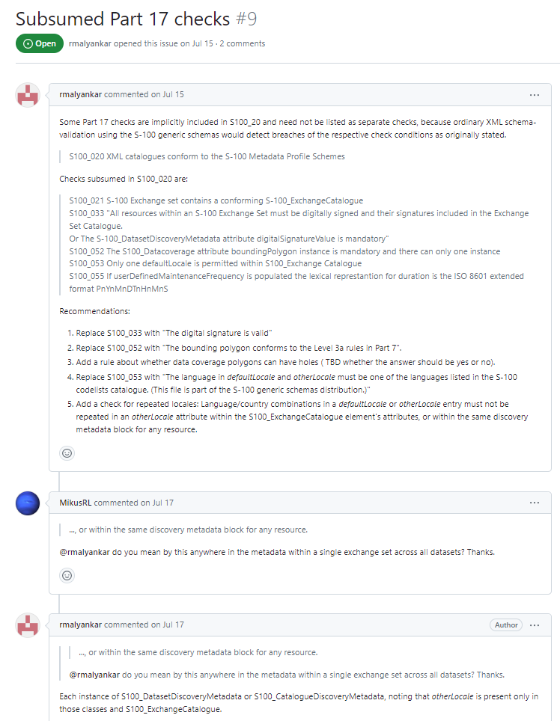
ISSUE 9

Slide 7
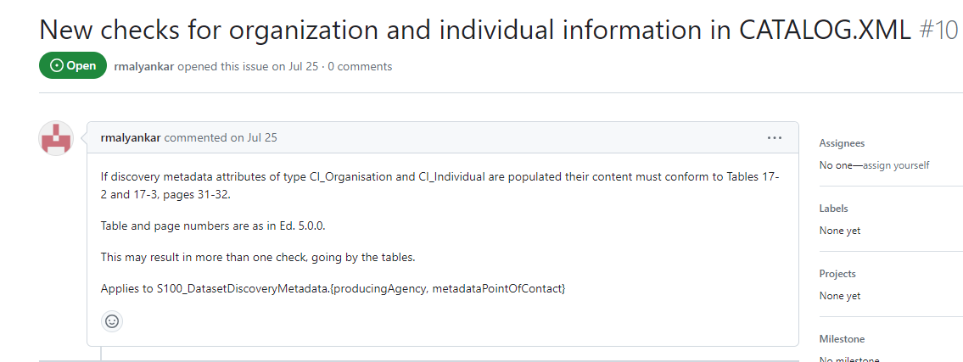
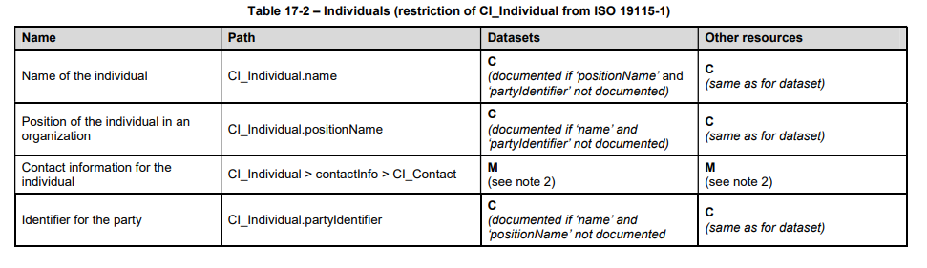
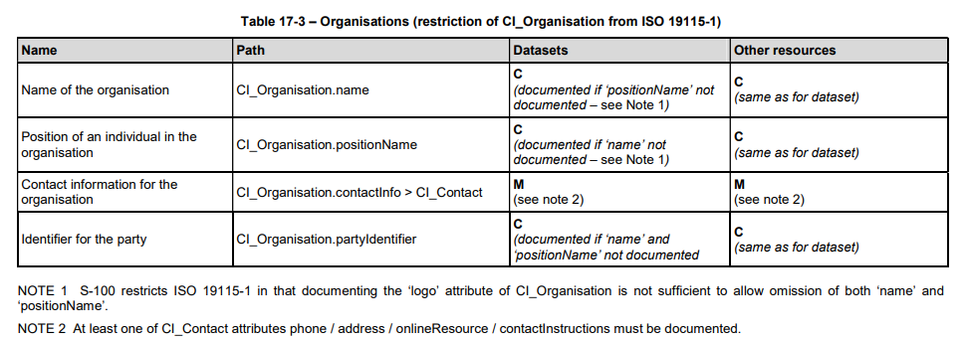
ISSUE 10

Slide 8
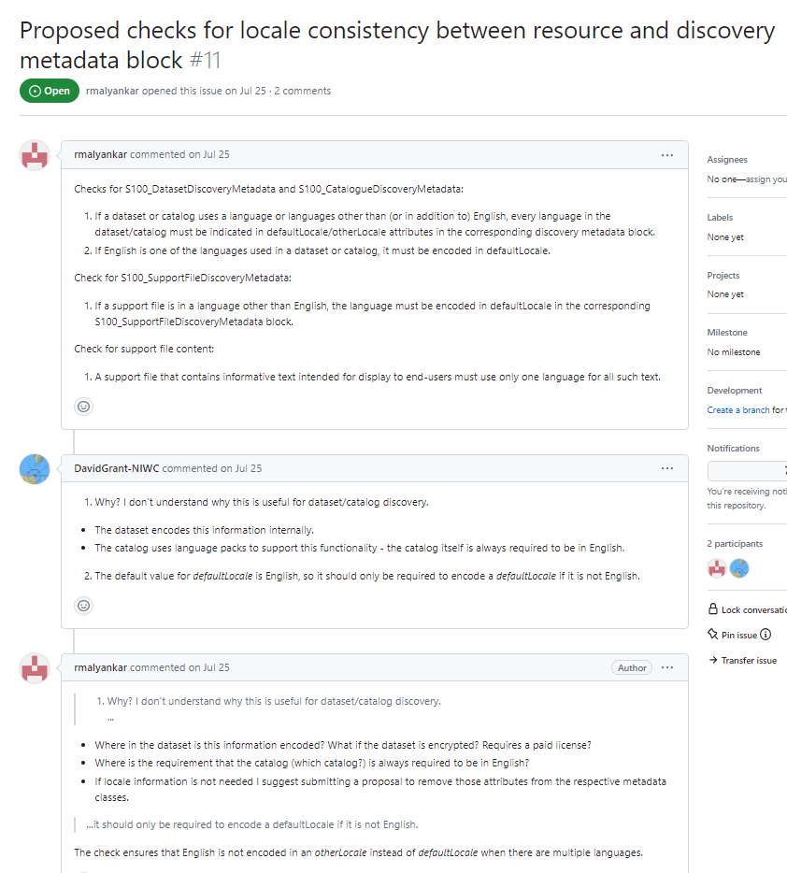
Issue 11

Slide 9
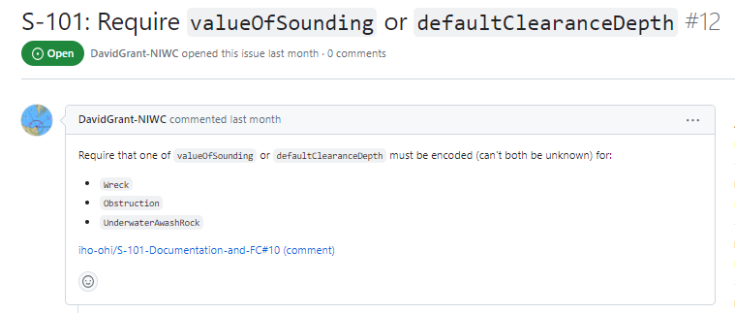
Issue 12
https://github.com/iho-ohi/S-101-Documentation-and-FC/issues/10#issuecomment-1667844996

Slide 10
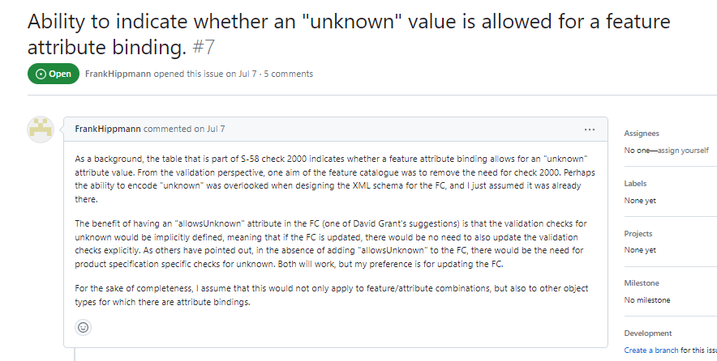
Issue 7
Proposal is being submitted to S-100 WG8 for discussion.
Close issue for now?
Overlap with Issue 4? https://github.com/iho-ohi/S-100-Validation-Checks/issues/4

Slide 11
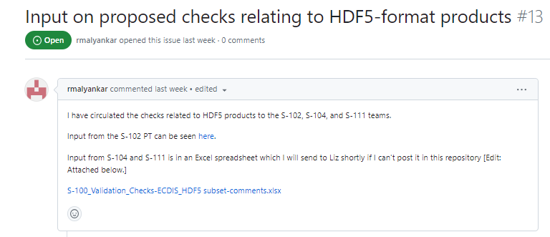
Issue 13
S-100_Validation_Checks-ECDIS_HDF5 subset-comments.xlsx

Slide 12
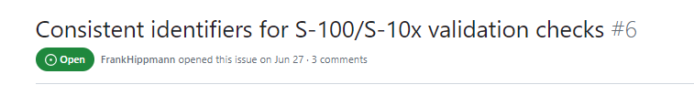
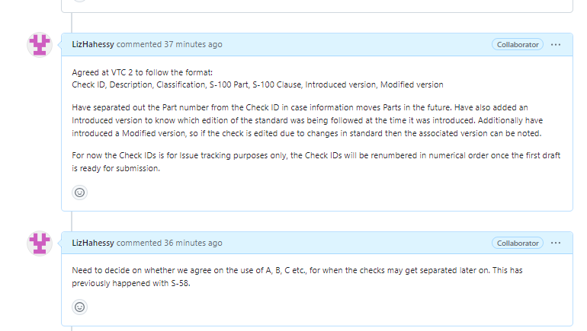
Issue 6
Propose close issue for now

Slide 13
Next steps
Continue producing a set of tests from Parts of S-100 & incorporate other tests (S-101, IIC etc.)
Tabulate and place on GitHub
Then group to comment and raise issues using Check ID in title
65 tests written from Part1, Part 2, Part 4b, Part 6, Part 17
Co-ordination meeting with S-101 Validation 5th September
Categorisation of tests – proposal for Lombok and agree on GitHub?
Interfaces with DQWG
Naming conventions across different validation tests
Document write up with an initial explanation of ‘what is S-100 level validation’

Slide 14
Deliverable – OCT 2023
Initial list of high level checks
Can be expanded upon afterwards
Document write up with an initial explanation of ‘what is S-100 level validation’

Slide 15
Work plan
ID | Task | Further Information | Who | Start Date | End date | Status
 | 1. Collate information an prepare Valdation Tests
1.1 | Establish GitHub page |  | Yong/ Liz |  |  | COMPLETE
1.2 | Contact Test Bed owners for input | SHOM/UKHO, KHOA & NO contacted. EU InterReg Project due to begin in 2023 - SE are leads (DK are members) | Liz | 01-04-2023 | 06-07-2023 | COMPLETE
1.3 | Contact DQWG for involvement | Chair contacted and agrees there is cross over between groups. Hopes to attend September VTC | Liz | 01-04-2023 | 06-07-2023 | COMPLETE
1.4 | Contact relevant PS owners | Contacted S-102, S-104, S-111, S-124, NIPWG generally, S-401 for information. | Liz | 01-04-2023 | 06-07-2023 | COMPLETE
1.5 | Contact Validation Software Manufacturers | Closing action as the software manufacturers are members of this group. If they have information to share please upload to GitHub or contact Liz & Yong | Liz | 01-04-2023 | 06-07-2023 | CLOSED
1.6 | Produce Work Plan | Work plan produced and will maintain | Liz | 01-04-2023 | 06-07-2023 | COMPLETE
1.7 | Raise awareness of this group | Members to raise awareness of this group when attending technical meetings | ALL | 01-04-2023 | 04-09-2023 | COMPLETE
1.8 | Review S-101 Proposed S-100 level tests | Uploaded to GitHub page. Need review for determing if should be carried forward to S-100 Validation tests and if need rewording. DK have begun an initial review | ALL | 01-07-2023 |  | IN PROGRESS
1.9 | Review S-129 Validation tests | Uploaded to GitHub page. Need review for determing if should be carried forward to S-100 Validation tests and if need rewording. Discussed at VTC2 that is is not in scope for this group. | ALL | N/A | N/A | ON HOLD
1.10 | Review S-124 Validation tests | Contacted chair for access to tests. Discussed at VTC2 that is is not in scope for this group. | ALL | N/A | N/A | ON HOLD
1.11 | Review S-104 Validation tests | Contacted chair for access to tests. Checks are on Registry need to contact for permission to post on GitHub page. Discussed at VTC2 that is is not in scope for this group. | Liz/All | N/A | N/A | ON HOLD
1.12 | Review S-102 Validation tests | Contacted chair for access to tests. Discussed at VTC2 that is is not in scope for this group. | ALL | N/A | N/A | ON HOLD
1.13 | Determine naming convention for tests | Intial proposal submitted - Issue 6 on GitHub. Proposal was amended during VTC2 to S100_xxx . It was questioned what the value of the Part number was and this could cause issues if S-100 changes Parts around as has done previously. Group to review and comment on for agreement by next VTC in September. | ALL | 01-07-2023 | 01-09-2023 | IN PROGRESS
1.14 | Agree categorisation of Validation tests |  | ALL | 01-07-2023 | 10-10-2023 | PLANNED
1.15 | Agree structure of Validation tests | Discussed briefly at VTC 2 and suggestions implemented regarding | ALL | 01-07-2023 | 10-10-2023 | IN PROGRESS
1.16 | Review relevant DQWG documentation | Identify and review relevant DQWG documentation | Liz initially to identify Group to review | 01-04-2023 | 01-09-2023 | PLANNED
1.17 | Review S-100 Parts for S-100 level Validation tests | Initial review has begun - Parts 1, 2, 6, 4b, 17 intially reviewed and posted for comment 07/07/23. | ALL | 01-04-2023 | 01-09-2023 | IN PROGRESS
1.18 | Develop cross check of PS validation tests to S-100 to identify gaps | This was proposed at S-101 PT meeting. Is this something we want to progress. Perhaps activity for after initial delivery at S-100 WG9. Potential collaboration with DQWG? Discussed at VTC 2 that is this not a task for this group. | ALL | N/A | N/A | ON HOLD
1.19 | Update Validation Diagram | Diagram initially produced for S-100 WG8. Group questionned relevance of diagram at VTC1, so work is on hold. Will reopen if required. | N/A | N/A | N/A | ON HOLD
1.20 | Update table outlining different types of Validation and who is responsible for them | Table initially produced for S-100 WG8. Group questionned relevance of diagram at VTC1, so work is on hold. Will reopen if required. May be needed for Introduction section to S-100 Validation Tests. | N/A | N/A | N/A | ON HOLD
1.21 | Produce a data flow diagram showing where valdiation takes place | Deemed not priority at this point due to resources available. Will reopen if required. | N/A | N/A | N/A | ON HOLD
1.22 | Produce a timeline | Deemed not priority at this point due to resources available. Will reopen if required. | N/A | N/A | N/A | ON HOLD
 | 2. Prepare draft delivery to S-100 WG9
2.1 | Produce wording for introduction to document on S-100 Validation |  |  |  | 10-10-2023 | PLANNED
2.2 | Draft Initial S-100 Validation tests focused on first phase S-100 deliveries |  |  |  | 10-10-2023 | PLANNED

Slide 16
Next meetings
S-101PT WG meeting - Lombok, Indonesia 27-29th September
Planned slot Friday 29th for 1 hour, VTC should be possible.
Monday October 23rd? To agree on submission to S-100 WG
November S-100 WG 8 meeting – Singapore 13-17th November

Slide 17
Any Questions?

